Slide 1
Shapes

Slide 2
Value with Overlapping Shapes
I can blend different values to show overlapping shapes.
Notes:
How many values do you see?

Slide 3
Shapes
Geometric:

Slide 4
Shapes
Organic:

Slide 5
At the Top of Paper
Draw 2 geometric shapes
Draw 2 organic shapes

Slide 6
Value Scale
On your four shapes create a value scale

Slide 7
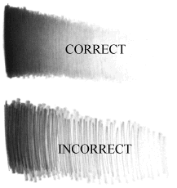
Blending
Make sure your value on your shapes are smooth.

Slide 8
Below your Shapes
Draw all four of your shapes overlapping

Slide 10
Value with Overlapping Shapes
Add value to your shapes.
Notes:
How many values do you see?

Slide 12
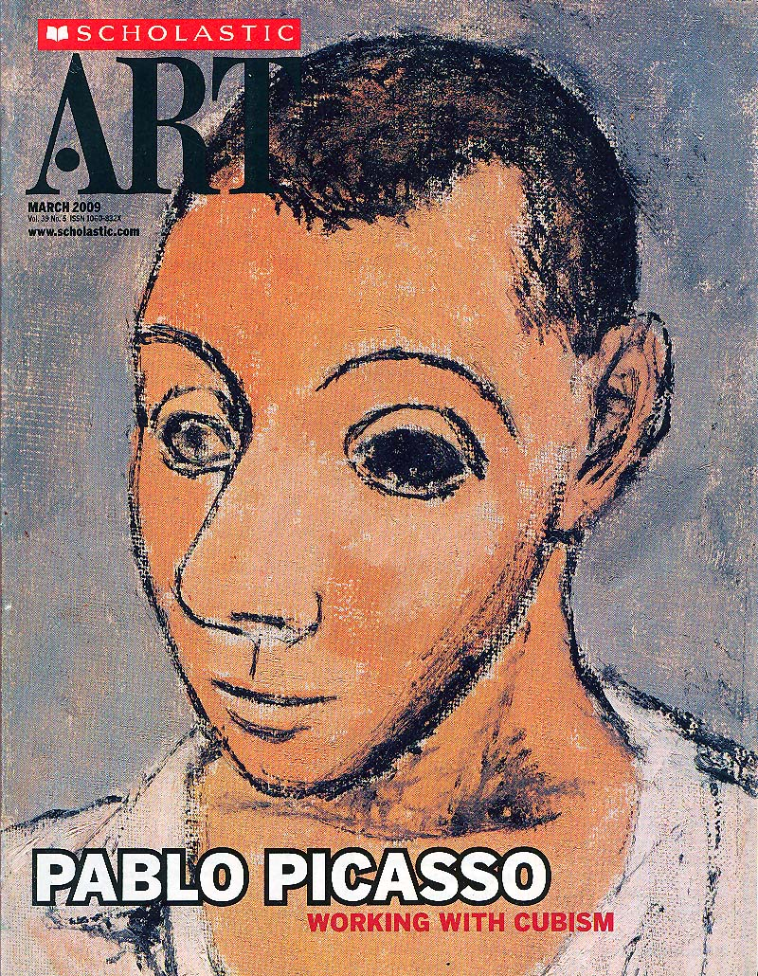
http://www.youtube.com/watch?v=zXLi9QKaPU4
Picasso biography 1
“The world today doesn’t make sense, so why should I paint pictures that do? -Pablo Picasso
http://www.youtube.com/watch?v=GS4bGwA0QSc
Bull fight
http://www.bbc.co.uk/news/entertainment-arts-12661727
http://www.youtube.com/watch?v=ow7eEWh37iU&feature=related
Picasso painting
http://www.youtube.com/watch?v=fjoWCdzhuFI&feature=fvw

Slide 13
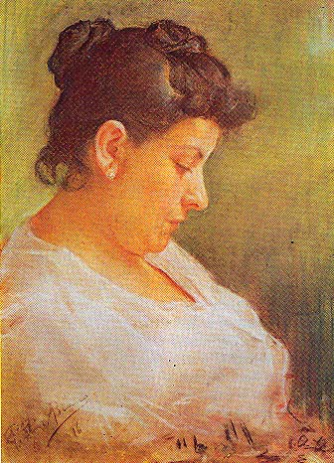
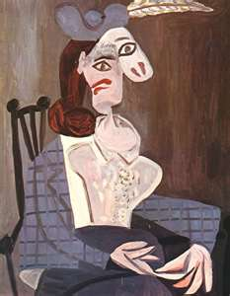

Slide 14
Pablo Picasso, “The Artist’s Mother” 1896
Pastel on Paper
Pablo Picasso, 1940’s
Oil Paint on Canvas

Slide 15
2: Say something about this artwork that is different than the other work of art.
1: Say something about this artwork that is different than the other work of art.
3: Both say something about the artworks that they have in common
5: Say something about this artwork that is different than the other work of art.
4: Say something about this artwork that is different than the other work of art.
6: Both say something about the artworks that they have in common
8: Say something about this artwork that is different than the other work of art.
7: Say something about this artwork that is different than the other work of art.
9: Both say something about the artworks that they have in common
Notes:
2 Dialogue Voice Poem

Slide 16
Differences and Similarities to think about
Colors
Shapes, patterns
Artist
Time of creation
Style (Abstract or Realistic)
Materials used
Notes:
Shoulder partner

Slide 17
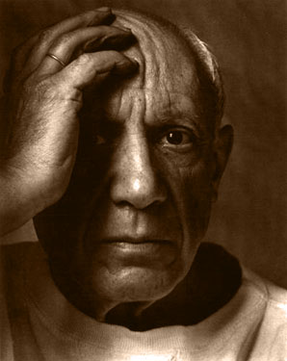
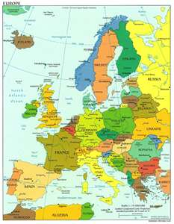
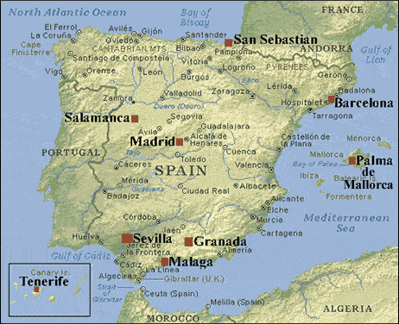
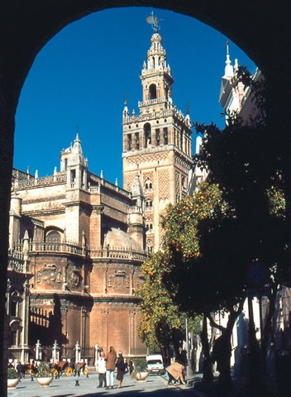
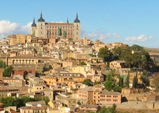
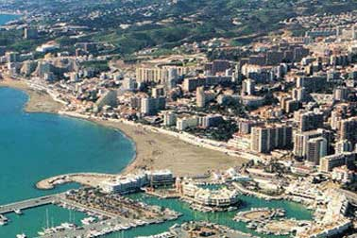
Pablo Picasso was born in 1881 in Spain.
Where is Spain on this map of Europe?
Toledo, Spain
Malaga, Spain
Seville, Spain

Slide 18
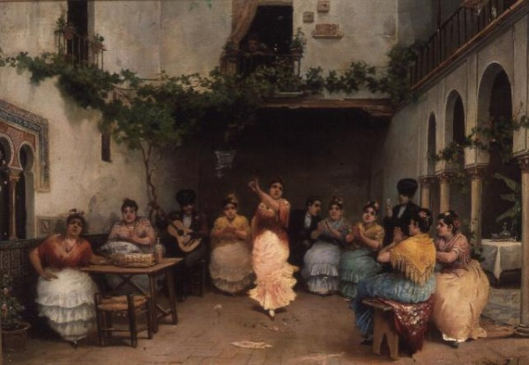
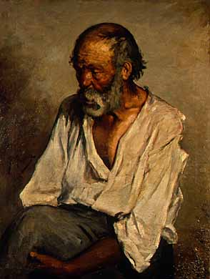
José Ruiz Blasco- Picasso’s father
Pablo Picasso, 1895
Picasso was born in 1881- How old was he when he made this painting?
Pablo Picasso’s father was a painter and an art teacher.
They would often paint together.
Notes:
When Picasso was 9, he finished a painting so perfectly that his father handed over his brushes and swore never to paint again. 14 years old

Slide 19
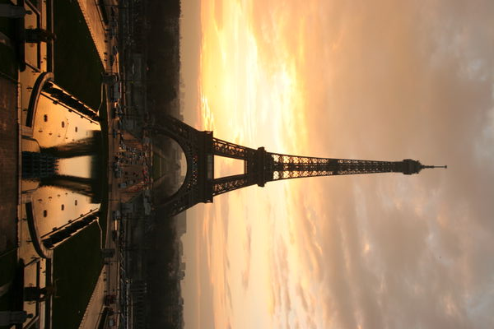
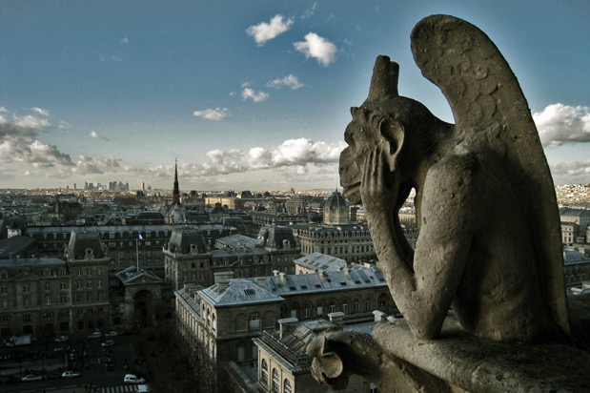
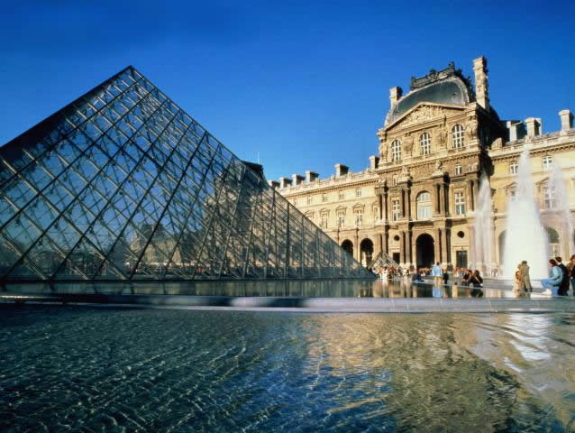
It was in Paris where Picasso began to explore museums and saw African Masks for the first time.
Notes:
When he was 19 he moved to paris

Slide 20
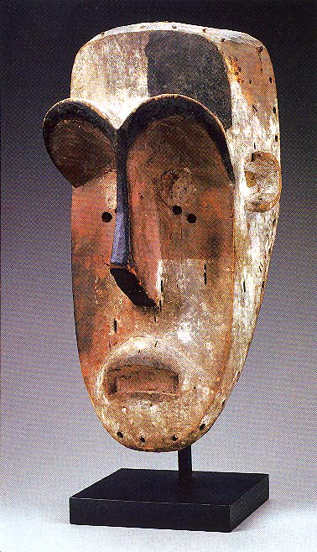
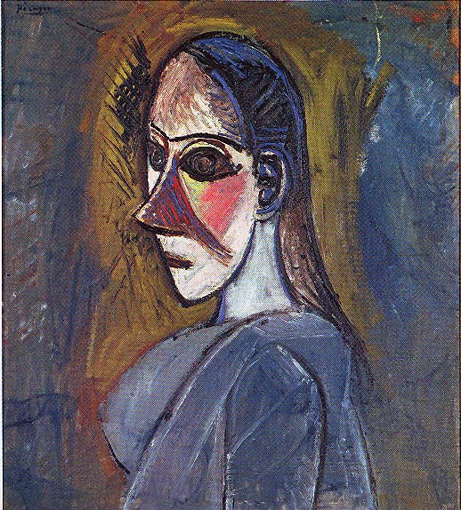
Picasso became fascinated with the way African Masks were simplified and how they were divided into flat planes.
“Bust of a Woman” 1907
How do you think the woman’s face resembles the African Mask?
Notes:
Partner discuss

Slide 21
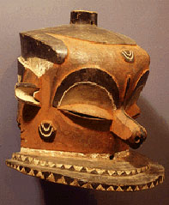
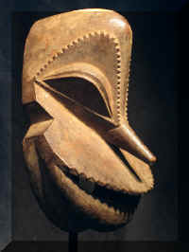
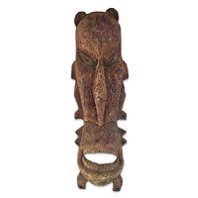
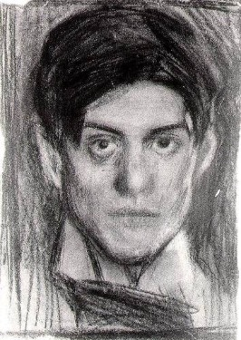
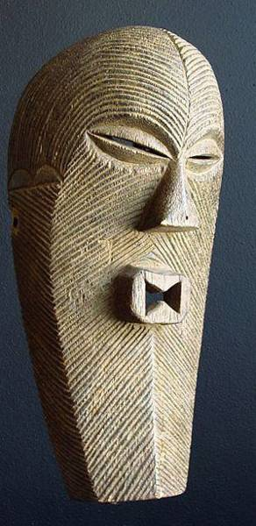
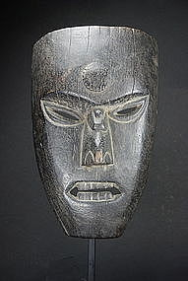
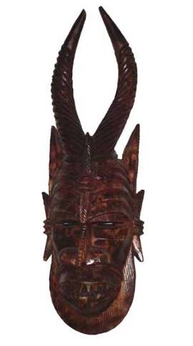
Instead of trying to create realistic copies of faces, the African Masks interpreted emotions and qualities like humor or fierceness.
Which of these masks seem humorous and which seem fierce? Any other emotions?
Picasso, “Self Portrait” Drawing

Slide 22
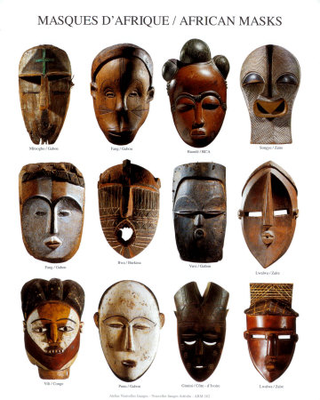
Picasso called African art an “art of reason” because he thought African artists depicted not what they saw but what they thought and felt.

Slide 23
Picasso began simplifying his paintings into basic geometric forms.
What geometric shapes can you find here?
Notes:
Partner disscuss

Slide 24
multiple points of view.
How is this painting different?
“Weeping Woman” 1937
Notes:
Picasso’s next step was showing a subject from multiple points of view. We normally see a subject from one point of view.

Slide 25
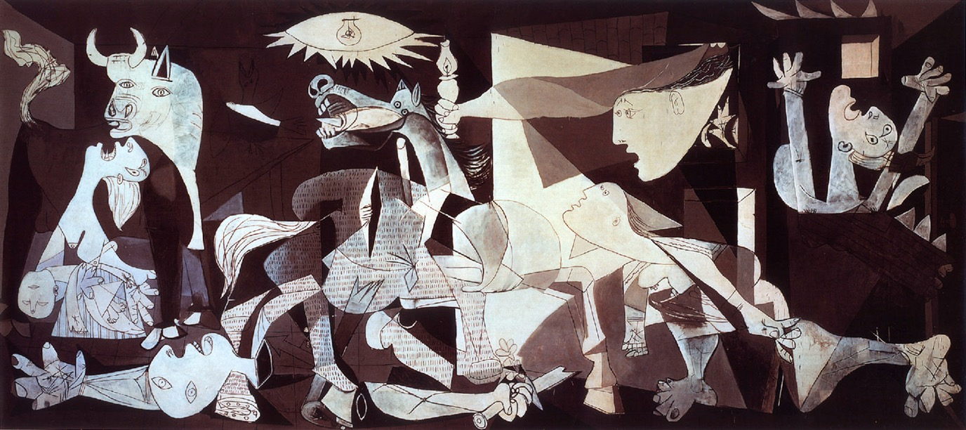
In 1936 a civil war broke out in Spain.
Guernica
http://www.youtube.com/watch?v=4drJL-pRTko
http://www.bing.com/videos/watch/video/the-bombing-of-guernica/a6af6f2695533f44b548a6af6f2695533f44b548-524825527866?q=guernica&adlt=strict
Guernica in Spanish 1:30 long
Notes:
Gernica. In 1937 German planes flew over the Spanish city of Guernica and released bombs for three hours killing between 250 & 1,600 civilians.

Slide 27
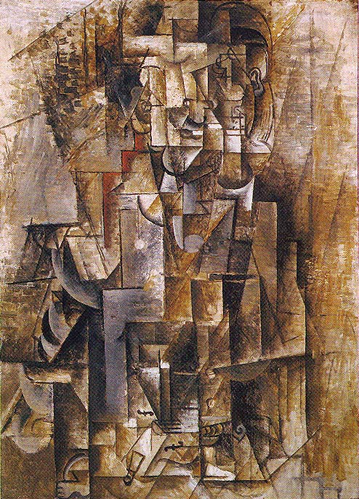
Here Picasso has combined different points of view into a single image to show the importance of all sides.
Can you find any clues in what this painting is of?
1911
Notes:
Man with a Violin. Shoulder partner

Slide 28
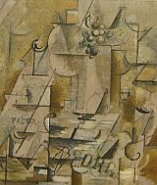
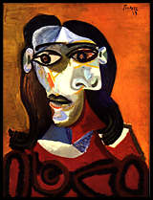
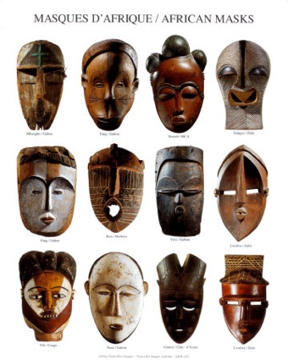
What is Cubism?
The essence of an object can only be captured by showing it from multiple points of view simultaneously.
Created by Georges Braque and Pablo Picasso.

Slide 29
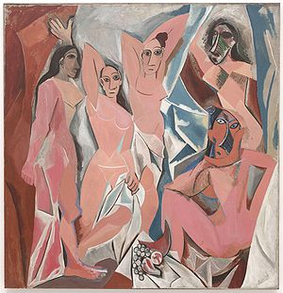
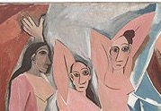
“Les Demoiselles d’Avignon/ The Young Ladies of Avignon” 1907
What can you find in this painting that deals with what we have been talking about?

Slide 30
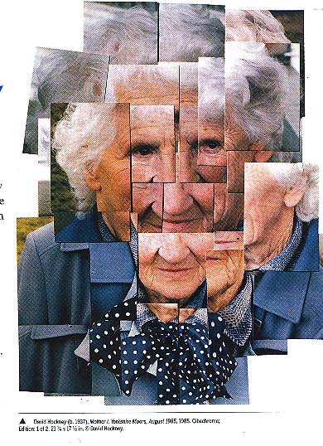
David Hockney, 1937
How is this Photograph considered Cubism?

Slide 31
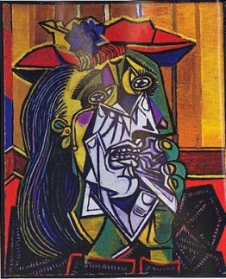
Go to www.picassohead.com
Create an example of a Cubistic Portrait
Email to heather.sulzen@nkcschools.org
MUST use MULTIPLE PERSPECTIVES!!!
Notes:
End Heather.sulzen@nkcschools.org

Slide 32
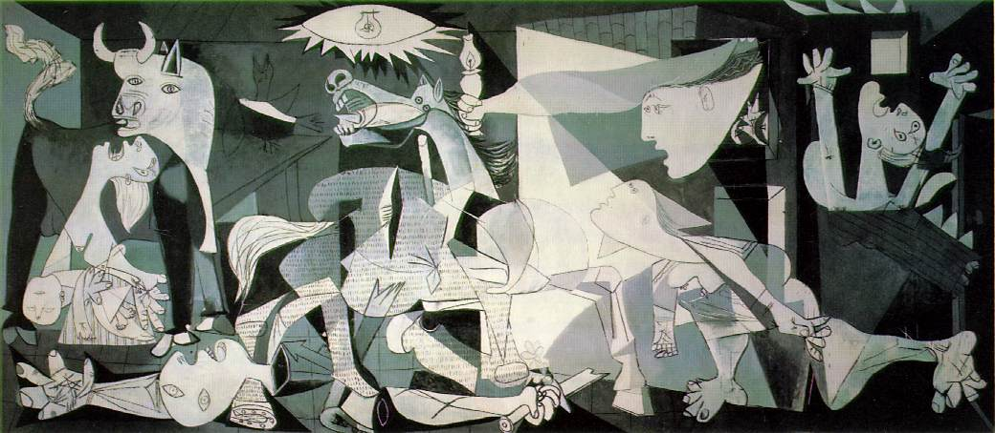
Cubism

Slide 33
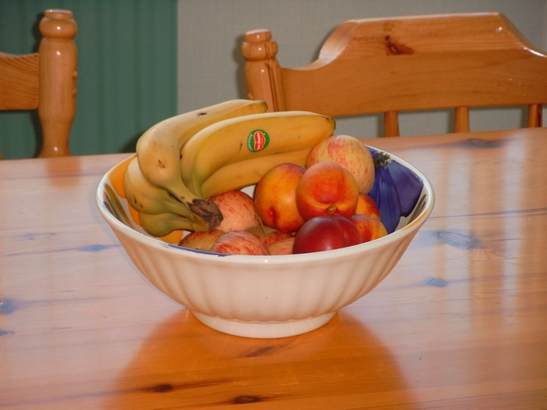
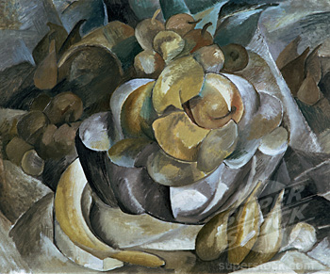
How is this painting an example of cubism?
Notes:
Broken mirror effect

Slide 34
Broken Mirror Effect
How is this the broken mirror effect?

Slide 35
Shapes
Geometric:
Draw three geometric shapes in your notes?

Slide 36
Shapes
Organic:
Draw three organic shapes in your notes?

Slide 37
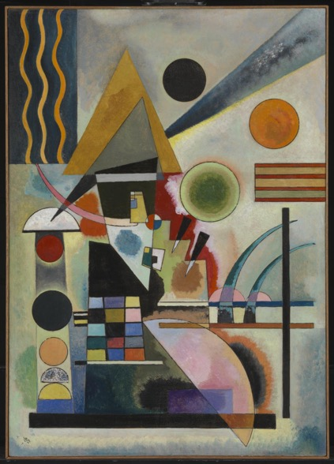
Non-objective
defines a type of abstract art that is usually, but not always, geometric and aims to convey a sense of simplicity and purity. Meaning no recognizable subject matter.

Slide 38
Which one is non-objective?

Slide 39
How to begin…
1.) Fill your paper with overlapping geometric shapes for the next 20 min. Have some going off the page.
Notes:
The lid size

Slide 40
How to begin…
2.) You need to decide which shapes are in front and which are behind. Erase the lines that go behind.

Slide 41
Value
Where a shape overlaps another you will show value by shading dark to light.
Notes:
Value The lightness or darkness of tones or colors.

Slide 42
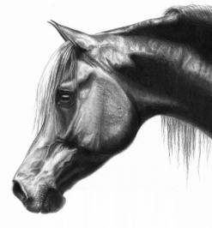
Blending
Shading from light to dark where you cannot see the pencil lines.
Do not use your finger to smudge-use tissue wrapped around your finger. (Please keep your tissue in your bin)

Slide 43
Blending
Notes:
why

Slide 44
3.) Add value in each shape.
Add VALUE!
Lights and darks
Use an ebony pencil
where a shape overlaps another you will show value by shading dark to light.
Notes:
From top to bottom while shading

Slide 45
4.) Organic forms on top of your geometric form.
Draw at least two large organic forms that do not overlap each other.
Both going off the paper.

Slide 46
Then draw at least 4 concentric organic repeating forms inside of each of your large organic forms.

Slide 47
5.) With your ebony or colored pencil go in and slightly darken the areas that your organic shapes overlap.
Do not add value to the geometric shapes outside of the large organic shape.

Slide 48
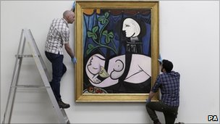
This is the most expensive painting ever sold at an auction. How much do you think it went for?
Notes:
106.5 million at the Tate Modern, London

Slide 49
Cubism in 3D
Jacques Lipchitz
At the Tate Modern, London

Slide 50
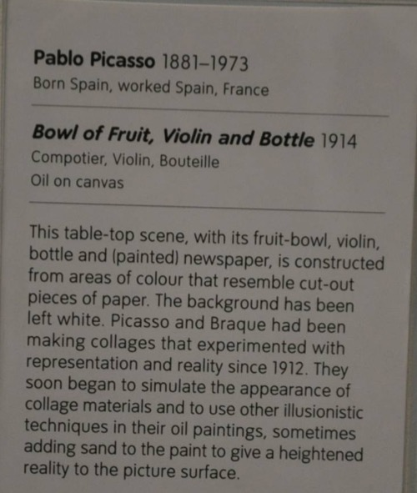

Slide 51
You will be graded on…
Composition: Is the composition complete and neat?
Variety: Are there a variety of marks, collage elements, values and materials used?
Observation: Is the drawing based on observation of the still life?
Cubism: Is the drawing portrayed in a Cubistic manner?

